Slide 1
Swing Layouts and Dialogs
Appendix E
Sun Certified Java Programmer Workshop

Slide 2
Contents
Using layout managers
Displaying dialog boxes
Demo project: DemoSwingLayoutsDialogs

Slide 3
1. Using Layout Managers
Overview of layout managers
Flow layout
Border layout
Grid layout
Box layout
Other layouts

Slide 4
Overview of Layout Managers
Swing uses layout managers to organize the overall arrangement of components in a window
You will typically use several layout managers in a window
Gives Swing insight into how to “flow” your components
We’ll take a look at the most common layout managers in this section
See the LayoutManagerDemo.java sample code

Slide 5
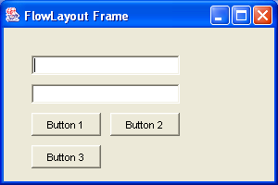
Flow Layout
Call setLayout(new FlowLayout())
public void demoFlowLayout() {
JFrame frame = new JFrame("FlowLayout Frame");
frame.setDefaultCloseOperation(JFrame.EXIT_ON_CLOSE);
JPanel pane = new JPanel();
// Set the layout manager (and border) for the JPanel.
pane.setLayout(new FlowLayout(FlowLayout.LEFT, 10, 10));
pane.setBorder(BorderFactory.createEmptyBorder(20, 20, 20, 20));
// Add components to the JPanel.
pane.add(new JTextField(20));
pane.add(new JTextField(20));
pane.add(new JButton("Button 1"));
pane.add(new JButton("Button 2"));
pane.add(new JButton("Button 3"));
// Add the JPanel to a JFrame, and display it.
frame.getContentPane().add(pane);
frame.setSize(300, 200);
frame.setVisible(true);
}

Slide 6
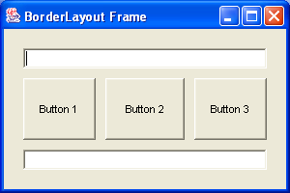
Border Layout
Call setLayout(new BorderLayout())
public void demoBorderLayout() {
JFrame frame = new JFrame("BorderLayout Frame");
frame.setDefaultCloseOperation(JFrame.EXIT_ON_CLOSE);
JPanel pane = new JPanel();
// Set the layout manager (and border) for the JPanel.
pane.setLayout(new BorderLayout(10, 10));
pane.setBorder(BorderFactory.createEmptyBorder(20, 20, 20, 20));
// Add components to the JPanel.
pane.add(new JTextField(20), BorderLayout.NORTH);
pane.add(new JTextField(20), BorderLayout.SOUTH);
pane.add(new JButton("Button 1"), BorderLayout.WEST);
pane.add(new JButton("Button 2"), BorderLayout.CENTER);
pane.add(new JButton("Button 3"), BorderLayout.EAST);
// Add the JPanel to a JFrame, and display it.
frame.getContentPane().add(pane);
frame.setSize(300, 200);
frame.setVisible(true);
}

Slide 7
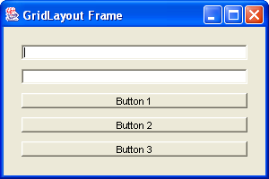
Grid Layout
Call setLayout(new GridLayout())
public void demoGridLayout() {
JFrame frame = new JFrame("GridLayout Frame");
frame.setDefaultCloseOperation(JFrame.EXIT_ON_CLOSE);
JPanel pane = new JPanel();
// Set the layout manager (and border) for the JPanel.
pane.setLayout(new GridLayout(5, 0, 10, 10)); // rows, cols, hgap, vgap.
pane.setBorder(BorderFactory.createEmptyBorder(20, 20, 20, 20));
// Add components to the JPanel.
pane.add(new JTextField(20));
pane.add(new JTextField(20));
pane.add(new JButton("Button 1"));
pane.add(new JButton("Button 2"));
pane.add(new JButton("Button 3"));
// Add the JPanel to a JFrame, and display it
frame.getContentPane().add(pane);
frame.setSize(300, 200);
frame.setVisible(true);
}

Slide 8
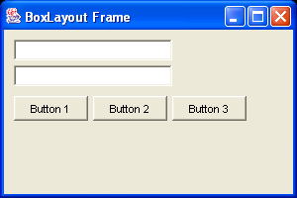
Box Layout
Very flexible way to organize complex user interfaces
Create panels with X-axis or Y-axis BoxLayout
Then add the panels to a top-level panel
public void demoBoxLayout() {
…
JPanel textPanel = new JPanel(); // Panel to hold text components.
JPanel buttonPanel = new JPanel(); // Panel to hold button components.
JPanel mainPanel = new JPanel(); // Contains the 2 other panels.
textPanel.setLayout(new BoxLayout(textPanel, BoxLayout.Y_AXIS));
textPanel.add(new JTextField(20));
textPanel.add(Box.createVerticalStrut(5));
textPanel.add(new JTextField(20));
buttonPanel.setLayout(new BoxLayout(buttonPanel, BoxLayout.X_AXIS));
buttonPanel.add(new JButton("Button 1"));
buttonPanel.add(Box.createHorizontalStrut(5));
buttonPanel.add(new JButton("Button 2"));
buttonPanel.add(Box.createHorizontalStrut(5));
buttonPanel.add(new JButton("Button 3"));
mainPanel.setLayout(new FlowLayout(FlowLayout.LEFT, 10, 10));
mainPanel.add(textPanel);
mainPanel.add(buttonPanel);
…
}

Slide 9
Other Layouts
CardLayout
Panels overlap just like in a tabbed pane, but without the tabs
DefaultMenuLayout
The layout manager used by menubars and popups
ScrollPaneLayout
The default layout manager used by JScrollPane
And more…
Lookup LayoutManager in the Swing API documentation, and find the list of known subclasses

Slide 10
2. Displaying Dialog Boxes
Overview of dialog boxes
Creating simple dialog boxes
Displaying a message dialog box
Displaying a confirmation dialog box
Displaying a dialog box with specific options
Displaying an input dialog box
Choosing files
Choosing colours
Displaying custom dialog boxes

Slide 11
Overview of Dialog Boxes
Most GUI applications need dialog boxes at some point
Swing provides standard dialog box classes for common tasks (file open, file save, colour chooser, etc).
You can also define custom dialog boxes
We’ll take a look at how to use standard dialogs and custom dialogs in this section
See the DialogBoxDemo.java sample code

Slide 12
Creating Simple Dialog Boxes
Use JOptionPane to create simple dialog boxes
Modal
Layout is managed implicitly
You can specify text, title, icon, screen location, and parent frame
Use one of the following class methods in JOptionPane
showMessageDialog() – For a message dialog
showConfirmDialog() – For a confirmation dialog
showOptionDialog() – For a dialog with specific options
showInputDialog() – For a dialog that gets user input

Slide 13
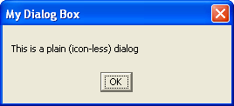
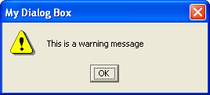
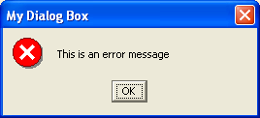
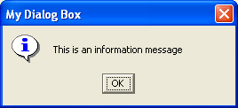
Displaying a Message Dialog Box
Call JOptionPane.showMessageDialog()
See demo function: displayMessageDialogBoxes()
JOptionPane.showMessageDialog(
null, // Parent component
"This is a plain (icon-less) dialog",
"My Dialog Box",
JOptionPane.PLAIN_MESSAGE);
JOptionPane.showMessageDialog(
null, // Parent component,
"This is a warning message",
"My Dialog Box",
JOptionPane.WARNING_MESSAGE);
JOptionPane.showMessageDialog(
null, // Parent component
"This is an error message",
"My Dialog Box",
JOptionPane.ERROR_MESSAGE);
JOptionPane.showMessageDialog(
null, // Parent component
"This is an information message",
"My Dialog Box",
JOptionPane.INFORMATION_MESSAGE);

Slide 14
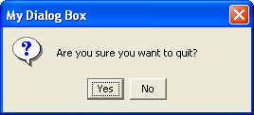
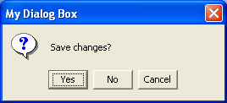
Displaying a Confirmation Dialog Box
Call JOptionPane.showConfirmDialog()
See demo function: displayConfirmationDialogBoxes()
To display Yes/No buttons:
To display Yes/No/Cancel buttons:
int result;
result = JOptionPane.showConfirmDialog(
null, // Parent component
"Are you sure you want to quit?",
"My Dialog Box",
JOptionPane.YES_NO_OPTION);
if (result == JOptionPane.YES_OPTION) { … }
int result;
result = JOptionPane.showConfirmDialog(
null, // Parent component
"Save changes?",
"My Dialog Box",
JOptionPane.YES_NO_CANCEL_OPTION);
if (result == JOptionPane.YES_OPTION) { … }

Slide 15
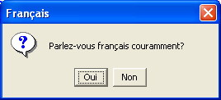
Displaying a Dialog Box with Specific Options
Call JOptionPane.showOptionDialog()
Specify what you want for the buttons
See demo function: displayOptionDialogBoxes()
Object[] options = { "Oui", "Non" };
int result;
result = JOptionPane.showOptionDialog(
null, // Parent component
"Parlez-vous français couramment?",
"Français",
JOptionPane.YES_NO_OPTION,
JOptionPane.QUESTION_MESSAGE,
null,
options,
options[0]);
if (result == JOptionPane.YES_OPTION) { … }

Slide 16
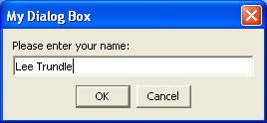
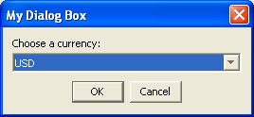
Displaying an Input Dialog Box
Call JOptionPane.showInputDialog()
See demo function: displayInputDialogBoxes()
Allow free-format text entry
Choose from a finite list of allowable options
String s;
s = (String) JOptionPane.showInputDialog(
null, // Parent component
"Please enter your name:",
"My Dialog Box",
JOptionPane.PLAIN_MESSAGE);
String s;
s = (String) JOptionPane.showInputDialog(
null, // Parent component,
"Choose a currency:",
"My Dialog Box",
JOptionPane.PLAIN_MESSAGE,
null,
new Object[] {"USD", "GBP", "EUR"},
"USD");

Slide 17
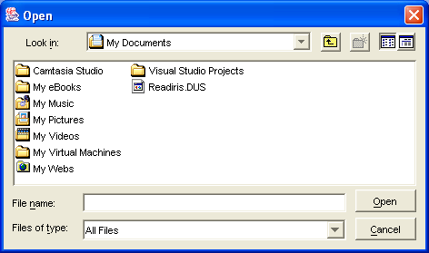

Choosing Files
Create a JFileChooser object…
See demo function: displayFileChooserDialogBoxes()
Call showOpenDialog() to display a file-open dialog
Call showSaveDialog() to display a file-save dialog
JFileChooser chooser = new JFileChooser();
if (chooser.showOpenDialog(null) ==
JFileChooser.APPROVE_OPTION) {
File file = chooser.getSelectedFile();
…
}
JFileChooser chooser = new JFileChooser();
if (chooser.showSaveDialog(null) ==
JFileChooser.APPROVE_OPTION) {
File file = chooser.getSelectedFile();
…
}

Slide 18
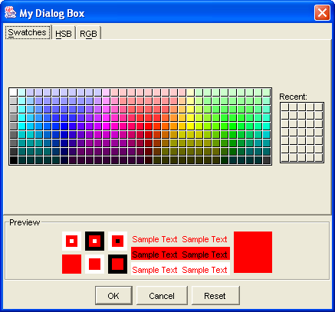
Choosing Colours
Call JColorChooser.showDialog()
See demo function: displayColorChooserDialogBoxes()
Color chosenColour;
chosenColour = JColorChooser.showDialog(
null,
"My Dialog Box",
Color.red);
if (chosenColour != null) {
…
}

Slide 19

Creating Custom Dialog Boxes
See demo function: displayCustomDialogBoxes()
// Create controls to display in the dialog (well, in a JPanel actually).
JLabel label = new JLabel("Enter text:");
JTextField textField = new JTextField(20);
JButton button = new JButton("Done");
JPanel pane = new JPanel();
// Add the controls to the JPanel.
pane.setBorder(BorderFactory.createEmptyBorder(5, 5, 5, 5));
pane.add(label);
pane.add(textField);
pane.add(button);
// Add the JPanel to a modal JDialog.
JDialog dialog = new JDialog((Frame)null, "My Dialog Box", true);
dialog.getContentPane().add(pane);
dialog.setDefaultCloseOperation(JDialog.DISPOSE_ON_CLOSE);
dialog.pack();
// Close the dialog when the user clicks the "Done" button.
button.addActionListener(new ActionListener() {
public void actionPerformed(ActionEvent e) {
dialog.setVisible(false);
}
});
// Display the dialog
dialog.setVisible(true);

Slide 20
Summary
Using layout managers
Displaying dialog boxes

